Slide 1
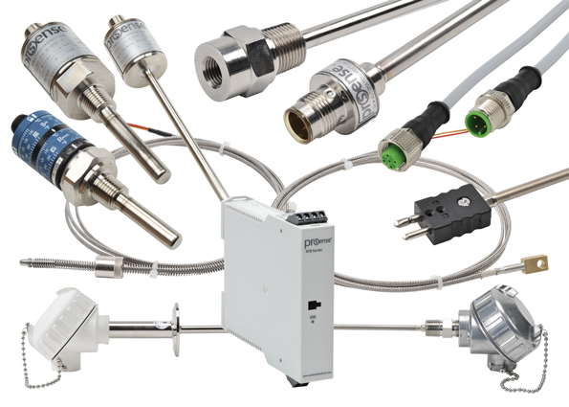
Predicting Batch Performance of Machines
By Team Kumaon

Slide 2
PROBLEM STATEMENT
Input parameters are the sensors attached to a machine, which are 54 in number. In the dataset, they are named as x0, x1, x2 … x54.
All the sensors attached to the machine are physically independent although there can be statistical dependency present in their values.
Then there is output parameter y2 which has to be considered independently. They describe the batch performance.
Batch performance is related to the machine’s state which is being captured by those 54 sensors. Hence this problem can be modeled as a multivariate regression problem where you train a model by looking at the machine’s state and compute the batch performance.
OBJECTIVE
Achieve the highest possible R squared score

Slide 3
DATA EXPLORATION
There are no Null Values.
All are Numerical columns.
In training data there are 794 rows and 387 columns.
In test data there are 89 rows and 386 columns
There are no missing values.

Slide 4
MODELS & APPROACHES
Since the data was in timestamp format. Took the average value for the seven days and updated it in the column.
Tried these many models:
RandomForestRegressor
Linear Regression
DecisionTreeRegressor
ExtraTreeRegressor
GradientBoostingRegressor

Slide 5
EVALUATION & RESULT
Achieved R2 score of 0.52 for label y2 with Decision Tree Regressor and submitted the code.

Slide 6

THANK YOU
Team Kumaon

